Slide 1
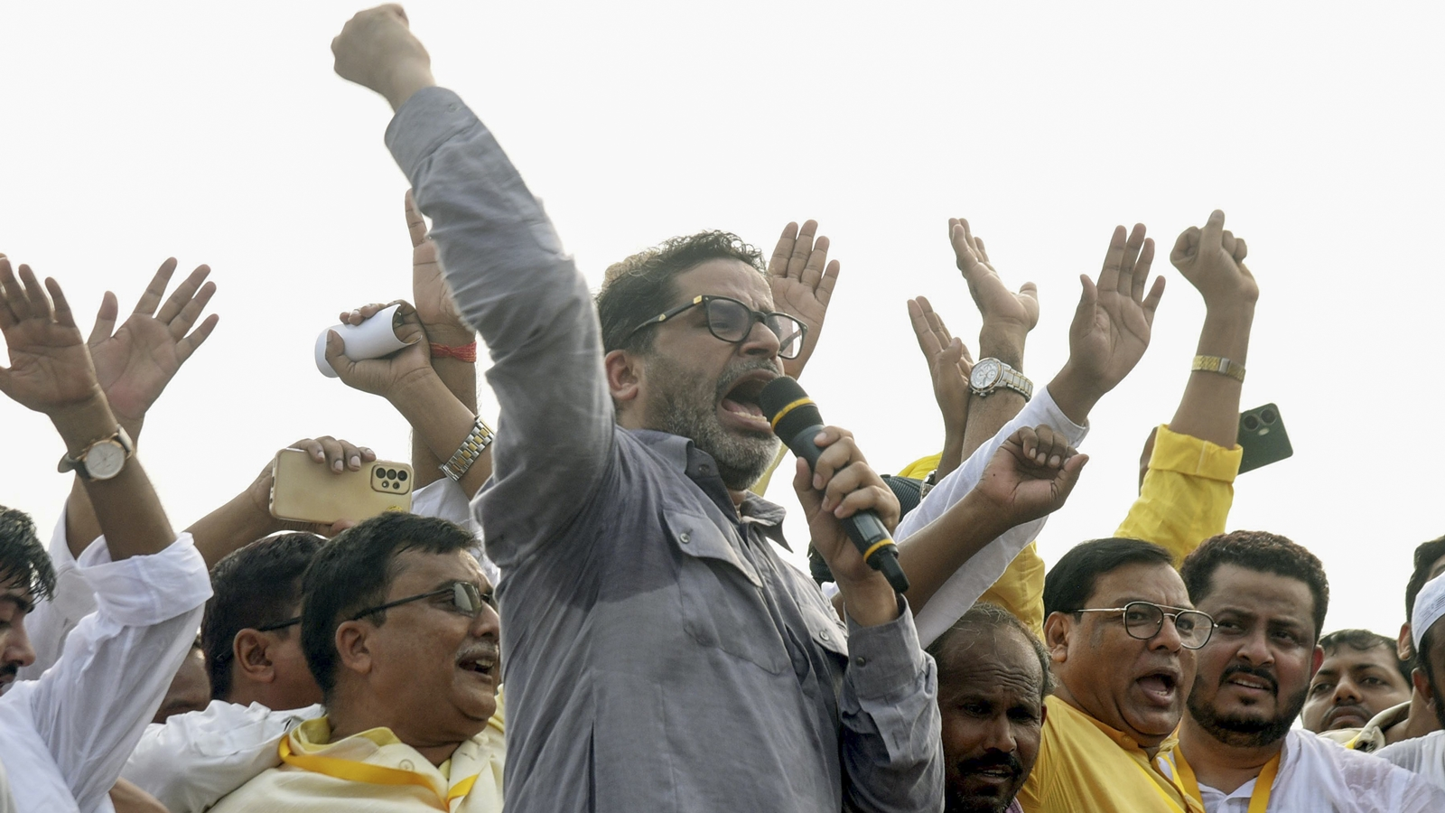
Jan Suraaj: The Complete Journey
2022 to 2026: From Padyatra to Political Victory
A movement for Bihar's transformation

Slide 2
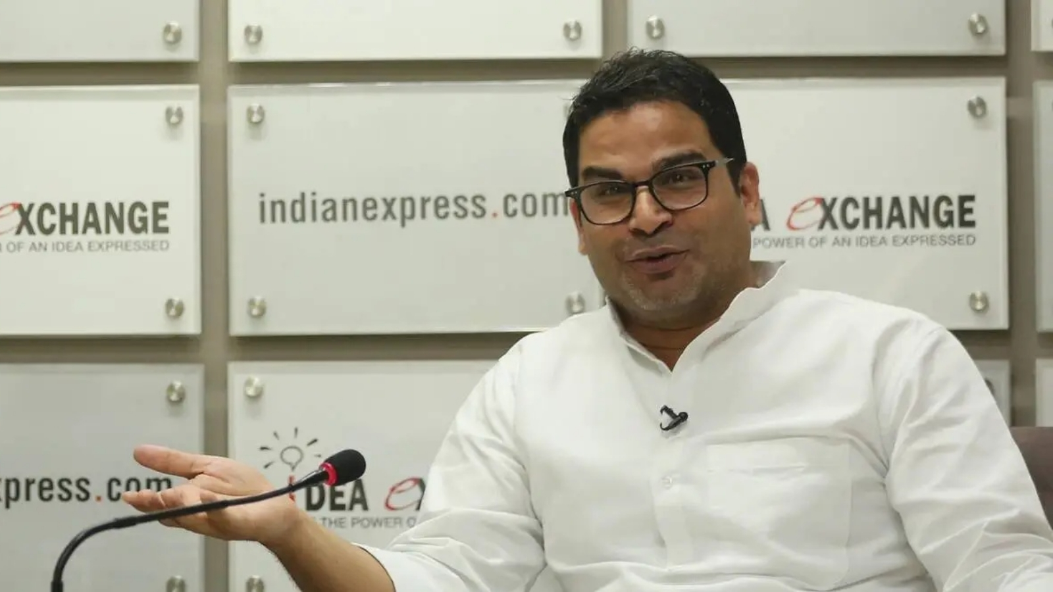
The Visionary: Prashant Kishor
Background & Inspiration
• Former UN public health official turned political strategist.
• Managed highly successful campaigns across India before turning focus to his home state, Bihar.
• Inspired by Jayaprakash Narayan (Sitab Diara) and Mahatma Gandhi.
• The 1280 Days Documentary highlights his realization during Covid-19 lockdowns about the plight of Bihari migrants (Palayan), extreme poverty (Garibi), and unemployment (Rojgar).

Slide 3

2022: The Genesis of Jan Suraaj
Oct 2: Launch of the Historic Padyatra
Bhitiharwa Gandhi Ashram
• Launched exactly where Mahatma Gandhi started his Satyagraha.
• The 3,500 km Padyatra (foot march) was designed to cover all 38 districts of Bihar.
• Goal: Understand grassroots problems without relying on intermediaries.
• Over 1280 days of intense struggle connecting directly with villages.

Slide 4
2023: Grassroots Expansion
Connecting with every Panchayat
Organizational Building
• Padyatra continues, gathering massive support across Bihar.
• April 2023: Jan Suraaj registers its first political win with Afaq Ahmad securing the Saran Teachers Constituency in the Bihar Legislative Council.
• The movement focuses heavily on youth empowerment and the Jan Suraaj Fellowship program.

Slide 5

2024: The Jan Suraaj Party
From Movement to Political Platform
• Oct 2, 2024: Official launch of the Jan Suraaj Party in Patna.
• Symbol: The 'School Bag', emphasizing Education as the path to liberation.
• Nov 2024: Contested by-elections in Tarari, Ramgarh, Belaganj, and Imamganj. Secured nearly 10% vote share despite not winning seats, establishing a strong foundation.

Slide 6
January 2025: Fighting for the Youth
BPSC Hunger Strike
The Gandhi Maidan Hunger Strike
• Prashant Kishor undertook a 14-day hunger strike (Aamran Anshan) demanding justice for students regarding BPSC paper leaks.
• Met with severe police action and FIRs, but stood firm.
• Established Jan Suraaj as the primary voice of the youth against systemic corruption.

Slide 7
2025: The Assembly Elections
Challenges and Restructuring
Electoral Challenge
• Contested 238 out of 243 seats in the Bihar Assembly Elections.
• Faced immense polarization and resource challenges against established alliances (NDA/Mahagathbandhan).
• Despite immense effort, the party did not win seats and secured ~3.4% vote share.
• Nov 2025: Prashant Kishor announces complete dissolution of the party structure to rebuild from scratch.

Slide 8
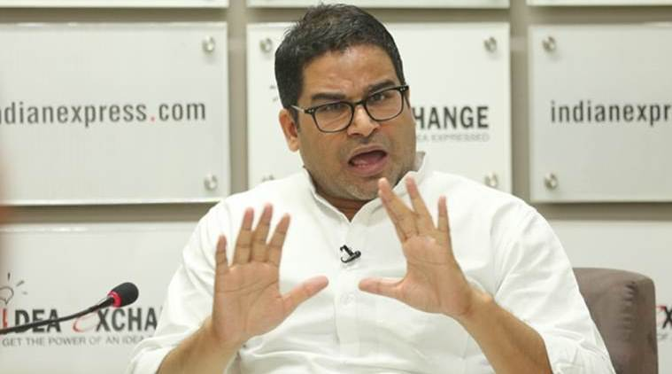
2026: The Breakthrough
Bankipur By-Election Victory
Prashant Kishor's Electoral Win
• July 30, 2026: Prashant Kishor wins his first election from the Bankipur constituency in Patna.
• Defeated BJP's Neeraj Kumar by a massive margin.
• This victory marked the ultimate validation of the 1280+ days of struggle and padyatra.

Slide 9
Bankipur By-Election Results
Statistical Breakdown
Candidate | Party | Votes | Vote Share (%)
Prashant Kishor | Jan Suraaj | 64,151 | 49.23%
Neeraj Kumar | BJP | 44,827 | 34.40%
Luv Sinha | INC (Mahagathbandhan) | 15,234 | 11.69%
Others/NOTA | - | 6,095 | 4.68%

Slide 10
The Road Ahead
Transforming Bihar
A New Dawn for Bihar
• The Bankipur victory is just the beginning.
• The mission remains: Stopping migration, providing world-class education, and generating employment.
• Jan Suraaj continues its journey as a mass movement dedicated to systemic change.

